Slide 1

Stephanie’s Creations: Sprint 5 Review
Team 5:
Hannah Clark | Heather Siler | Lauren Geis
Notes:
Presenter: Lauren
Transition to next Presenter: NA this slide
Speaking Points
Good evening everyone! Our goal today is to provide a detailed story and demonstrate the value we've delivered in this sprint. We'll focus on how these deliverables contribute to the overall project objectives.
The value delivered in this Sprint will be realized in future construction of our IS for Stephanie. Once created and implemented our it will save her an estimated 200 hours annually in Inventory Management, Sales and Order Processing, Financial Reporting and Customer Communication.
This time can be reinvested into product creation, marketing, and business growth. We expect Stephanie to increase sales by 20% within the first year of implementing the IS we are creating for her this semester

Slide 2
Sprint 5 Introduction
Migration Plan
Sprint Highlights
Business Readiness
Technical Readiness
People Readiness
Sprint Backlog
Sprint Burndown
Sprint PSPI
Notes:
Presenter: Lauren
Transition to next Presenter: NA this slide
This Sprint our team spent extra time reflecting on the feedback received previously. As a result, we have decided to focus on demonstrating clear communication and iterative progress toward completion of this project for you tonight.
In terms of deliverables, Sprint 3 was focused on solidifying our understanding of the system's data flow and structure. We've made significant progress in documenting and visualizing these critical aspects. This sprint was important for laying a solid foundation for the development sprints that follow.

Slide 3
Migration plan
Notes:
Presenter: Lauren
Transition to next Presenter: NA this slide
Let's start with the Data Flow Diagram (DFD) package. This is a crucial deliverable as it visually represents how data moves through the system. We've completed revisions to the Context Diagram and construction the DFD Level 0 and Level 1 for all five of the core processes for the system.
We believe the combined 10 hours of time invested in our DFD Package this Sprint will prevent at least 20 hours of rework time in future sprints.
For our client, Stephanie, we believe a well designed IS will save her valuable time that can be invested in other areas to grow her business like creating new product and marketing.

Slide 4
Business Readiness
-Go-Live Verification
-Parallel Run Monitoring
-Business Process Monitoring
-Stakeholder Communication
Technical Readiness
-System Performance Monitoring
-Infrastructure Stability Checks
-Security Monitoring
-Log Analysis
People Readiness
-Go-Live Support
-User Feedback
-Refresher Training
-Knowledge Transfer
Notes:
Presenter: Lauren
Transition to next Presenter: NA this slide
For Sprint 3, we simplified our Context Diagram in order to make it more approachable for Stephanie.
By investing time in thorough analysis of data flow by providing a clear and concise visual representation, we have reduced the risk of costly errors and ensure that the system meets the needs of Stephanie’s business.
This level of documentation also facilitates better communication between developers and business stakeholders. By ensuring Stephanie has a thorough understanding of how data will flow through the IS at this stage, we will decrease the amount of time it takes her to be trained. There's a strong correlation between client involvement in DFD creation and a quantifiable decrease in the time it takes for them to become comfortable with a new Information System (IS). Our original estimate of the time frame for Stephanie to become proficient was 2 months. By leveraging the DFD package, our new estimate cuts that in half to only 1 month.

Slide 5
Business Readiness
Activity | Focus | Action | Success
Go-Live Verification | Verify core functions | Execute documented test cases (Business Analysts, Key Users) | Completion of all critical test cases
Parallel Run Monitoring | Compare order volume, processing time, error rates between old/new systems | Daily monitoring of defined metrics (Business Analysts) | New system performance meets/exceeds old system
Business Process Monitoring | Identify inefficiencies in new system | Weekly review of process flows (Business Analysts) | Continuous improvement in process efficiency based on monitoring
Stakeholder Communication | Communication of system status and issues | Daily status emails, progress meetings (Project Manager) | Issues communicated within 24 hours and resolution suggested/implemented within 24 hours.
Notes:
Presenter: Lauren
Transition to next Presenter: NA this slide
For Sprint 3, we simplified our Context Diagram in order to make it more approachable for Stephanie.
By investing time in thorough analysis of data flow by providing a clear and concise visual representation, we have reduced the risk of costly errors and ensure that the system meets the needs of Stephanie’s business.
This level of documentation also facilitates better communication between developers and business stakeholders. By ensuring Stephanie has a thorough understanding of how data will flow through the IS at this stage, we will decrease the amount of time it takes her to be trained. There's a strong correlation between client involvement in DFD creation and a quantifiable decrease in the time it takes for them to become comfortable with a new Information System (IS). Our original estimate of the time frame for Stephanie to become proficient was 2 months. By leveraging the DFD package, our new estimate cuts that in half to only 1 month.

Slide 6
Technical Readiness
Activity | Focus | Action | Success
System Performance Monitoring | Ensure system stability/performance against KPIs | Continuous monitoring using Prometheus/Grafana (System Admin, DevOps) | System performance within defined thresholds (Response Time <3 secs, CPU <70%)
Infrastructure Stability Checks | Verify health of servers, network, and databases | Execute automated health checks and manual reviews (System Admin) | No critical infrastructure failures
Security Monitoring | Detect and respond to security threats | Continue monitoring using SIEM (System Admin, Security Team) | No successful security breaches
Log Analysis | Identify potential issues through log review | Analyze system, application and security logs. (System Admin, Technical Leads) | Proactive identification and resolution of issues – within 24 hours
Notes:
Presenter: Lauren
Transition to next Presenter: NA this slide
For Sprint 3, we simplified our Context Diagram in order to make it more approachable for Stephanie.
By investing time in thorough analysis of data flow by providing a clear and concise visual representation, we have reduced the risk of costly errors and ensure that the system meets the needs of Stephanie’s business.
This level of documentation also facilitates better communication between developers and business stakeholders. By ensuring Stephanie has a thorough understanding of how data will flow through the IS at this stage, we will decrease the amount of time it takes her to be trained. There's a strong correlation between client involvement in DFD creation and a quantifiable decrease in the time it takes for them to become comfortable with a new Information System (IS). Our original estimate of the time frame for Stephanie to become proficient was 2 months. By leveraging the DFD package, our new estimate cuts that in half to only 1 month.

Slide 7
People Readiness
Activity | Focus | Action | Success
Go-Live Support | Provide timely support to users | Manage support requests with SLA targets (System Admin, Technical Team) | Requests resolved within 24 hours
User Feedback Collection | Gather user experience feedback | Post-go-live surveys (Project Manager, Business Analyst) | User satisfaction remains > 80% positive feedback
Refresher Training | Provide additional training based on support request and feedback surveys | Schedule and deliver targets training sessions (Project Manager, Business Analyst) | Reduction in number of support tickets
Knowledge Transfer | Ensure internal teams have sufficient knowledge to support the system | Regular documentation reviews and knowledge-sharing sessions (Project Manager, Business Analyst, System Admin) | Reduction in regular support provided by the project team to maintain typical system maintenance
Notes:
Presenter: Lauren
Transition to next Presenter: NA this slide
For Sprint 3, we simplified our Context Diagram in order to make it more approachable for Stephanie.
By investing time in thorough analysis of data flow by providing a clear and concise visual representation, we have reduced the risk of costly errors and ensure that the system meets the needs of Stephanie’s business.
This level of documentation also facilitates better communication between developers and business stakeholders. By ensuring Stephanie has a thorough understanding of how data will flow through the IS at this stage, we will decrease the amount of time it takes her to be trained. There's a strong correlation between client involvement in DFD creation and a quantifiable decrease in the time it takes for them to become comfortable with a new Information System (IS). Our original estimate of the time frame for Stephanie to become proficient was 2 months. By leveraging the DFD package, our new estimate cuts that in half to only 1 month.

Slide 8




Implementation Timeline
Go-Live
Monitoring
Feedback & Re-Training
Migration Complete
May 31, 2025
June 4, 2025
June 14, 2025
July 29, 2025

Slide 9
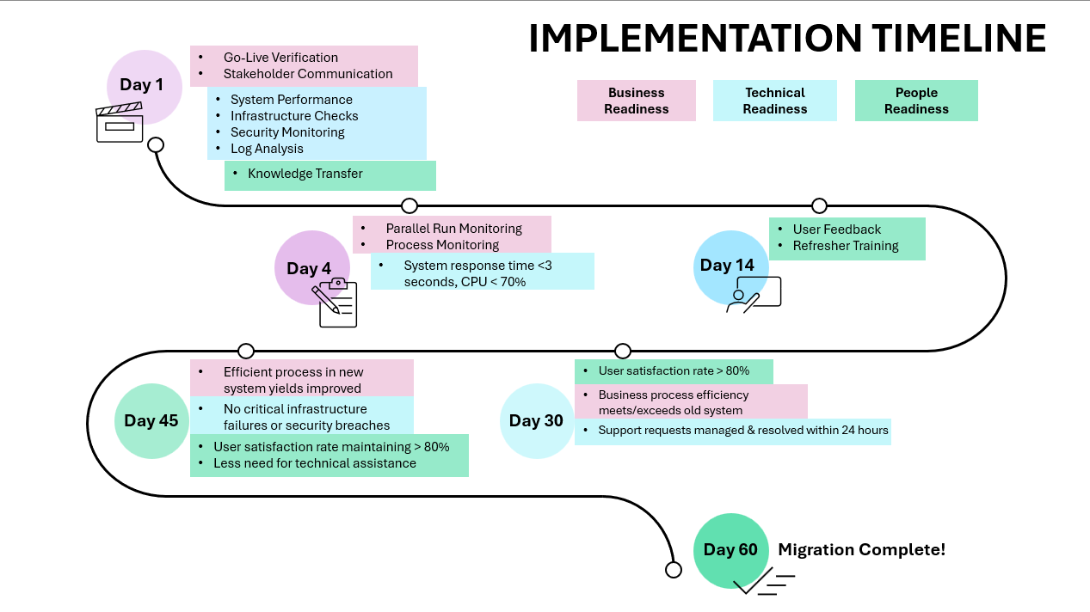
Notes:
Presenter: Lauren
Transition to next Presenter: NA this slide
For Sprint 3, we simplified our Context Diagram in order to make it more approachable for Stephanie.
By investing time in thorough analysis of data flow by providing a clear and concise visual representation, we have reduced the risk of costly errors and ensure that the system meets the needs of Stephanie’s business.
This level of documentation also facilitates better communication between developers and business stakeholders. By ensuring Stephanie has a thorough understanding of how data will flow through the IS at this stage, we will decrease the amount of time it takes her to be trained. There's a strong correlation between client involvement in DFD creation and a quantifiable decrease in the time it takes for them to become comfortable with a new Information System (IS). Our original estimate of the time frame for Stephanie to become proficient was 2 months. By leveraging the DFD package, our new estimate cuts that in half to only 1 month.

Slide 10
Sprint highlights
Notes:
Presenter: Lauren
Transition to next Presenter: NA this slide
Next, we'll look at the Entity Relationship Diagram (ERD). The ERD provides a clear picture of the data entities and their relationships.
The ERD is a key foundation for our database design. It ensures data consistency and reduces redundancy.

Slide 11
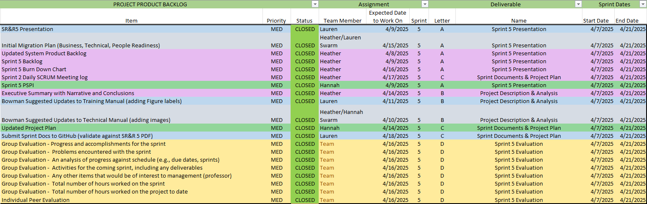
Notes:
Presenter: Heather
Transition to next Presenter: NA this slide
This is our Sprint 3 Burn Down Chart. As you can see, we have completed all work for this sprint, and are on target for future sprints.
I would like to take a moment to explain the spike in activity and effort above the ideal line on our Burn Down Chart. After completing our assigned backlog items individually, our team decided to collaborate on the best ways to incorporate engaging visuals and feedback received previously into our Sprint 3 work.
We hope our efforts led to stronger a presentation and delivery for you tonight. We also hope you enjoyed the story we told tonight as we focused on the benefits of deliverables and work for our team and our client
Lastly tonight,

Slide 12
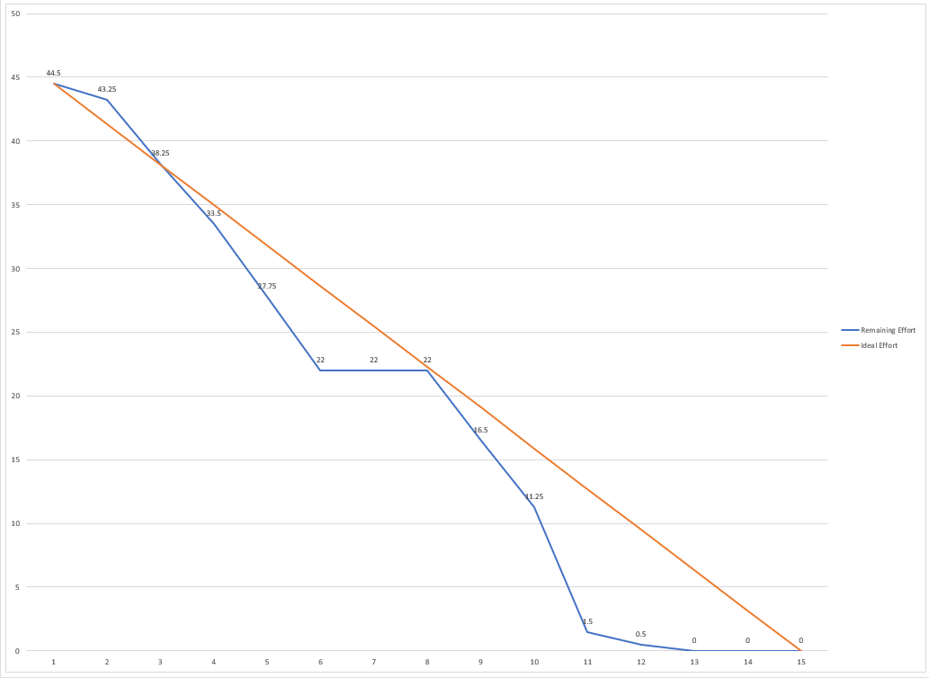
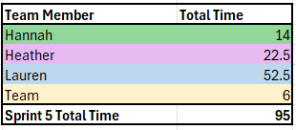
Notes:
Presenter: Heather
Transition to next Presenter: NA this slide
This is our Sprint 3 Burn Down Chart. As you can see, we have completed all work for this sprint, and are on target for future sprints.
I would like to take a moment to explain the spike in activity and effort above the ideal line on our Burn Down Chart. After completing our assigned backlog items individually, our team decided to collaborate on the best ways to incorporate engaging visuals and feedback received previously into our Sprint 3 work.
We hope our efforts led to stronger a presentation and delivery for you tonight. We also hope you enjoyed the story we told tonight as we focused on the benefits of deliverables and work for our team and our client
Lastly tonight,

Slide 13
Notes:
Presenter: Heather
Transition to next Presenter: NA this slide
This is our Sprint 3 Burn Down Chart. As you can see, we have completed all work for this sprint, and are on target for future sprints.
I would like to take a moment to explain the spike in activity and effort above the ideal line on our Burn Down Chart. After completing our assigned backlog items individually, our team decided to collaborate on the best ways to incorporate engaging visuals and feedback received previously into our Sprint 3 work.
We hope our efforts led to stronger a presentation and delivery for you tonight. We also hope you enjoyed the story we told tonight as we focused on the benefits of deliverables and work for our team and our client
Lastly tonight,

Slide 14

Any Questions?
Notes:
Presenter: Heather
Transition to next Presenter: NA this slide
we would like to encourage your feedback on the deliverables we demo’d.
Your input is crucial for ensuring that we are on the right track.
Please feel free to ask any questions or share any feedback you have now.

